Slide 1
1.Log in to the AWS Management Console - Go to the EC2 Dashboard -Click on the
"Launch Instance" button.
2.Go the Amazon ECR service page
Click the “Create repository” button- give your repository name –created repository
3.And then create the IAM roles –amazonfull accessresgistryaccess- create role
JENKINS FILE :

Slide 2
4.Click the ec2 instance –click right button-security –modifyIAM role-here give iam roles acces.
5.Then connect to the ec2 instance in terminal.
6.And then install Jenkins- and then install Docker – Git also installhere –
7.And then clone the project here
8.Go to project – then create dockerfile nodejs- then create the image and push the image .
9.And then create the jenkinsfile in github – write the code (pipeline )
And then here give the aws ecr id and region and exicut the ecr command in terminal .
And pen the Jenkins dashboard - create the project –then give the git repository and git credentials
-- and then give the Jenkins path and branch .

Slide 3
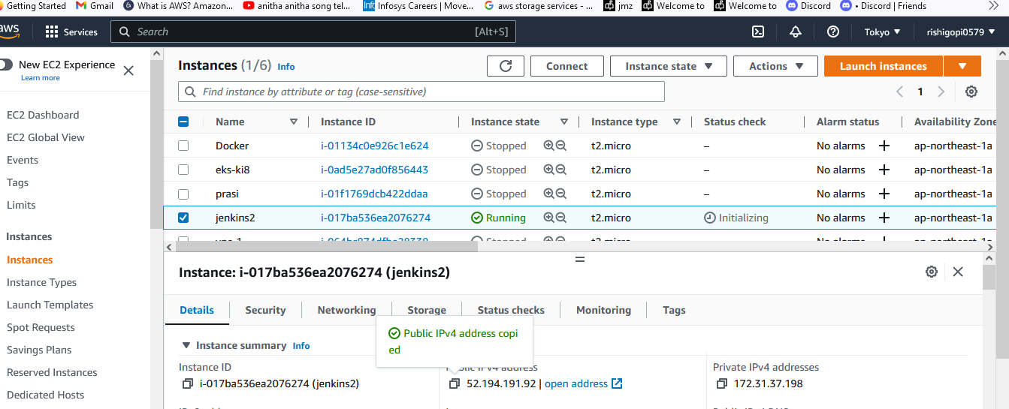

Slide 4
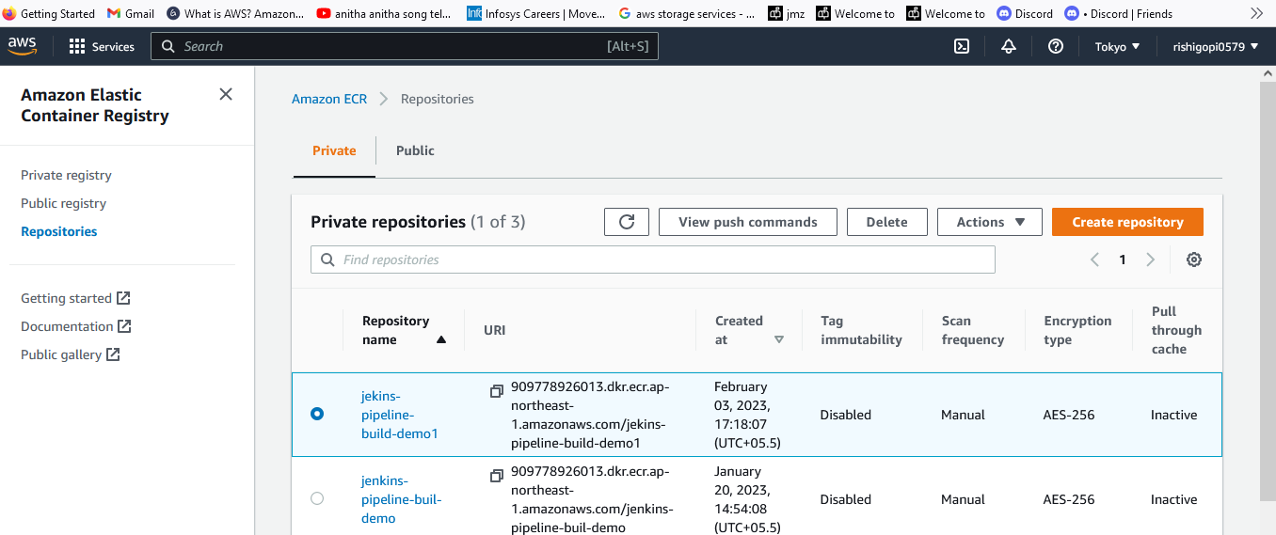

Slide 5
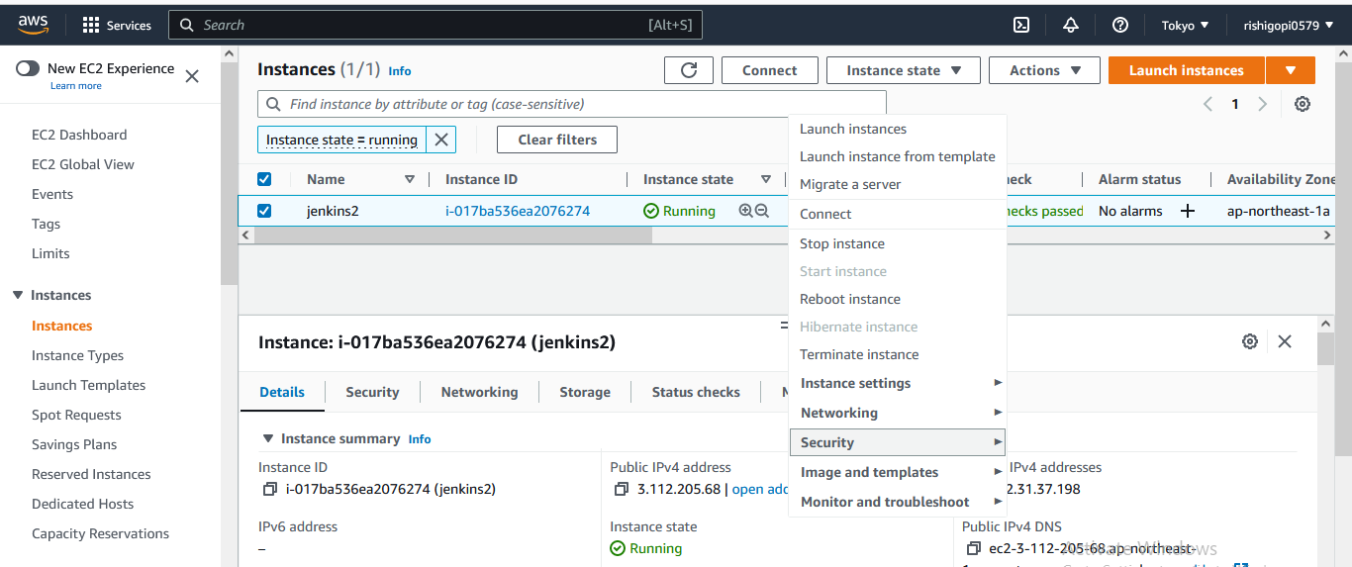

Slide 6
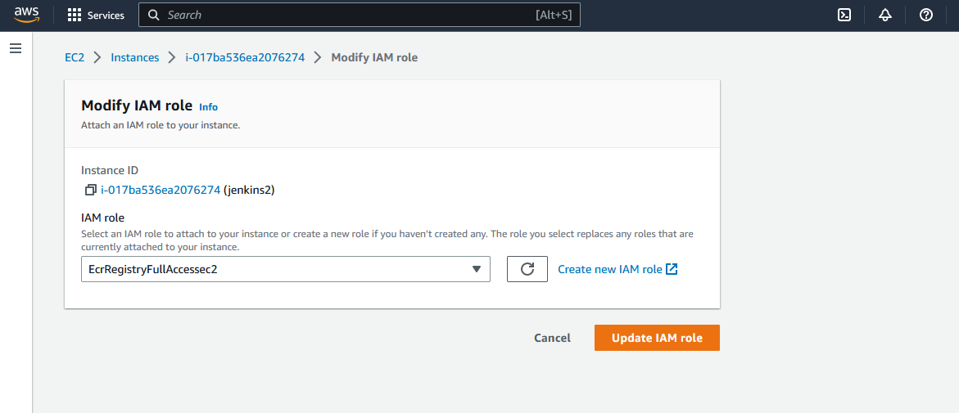

Slide 7
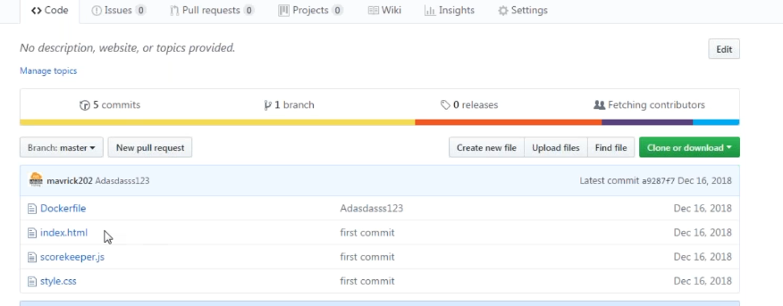

Slide 8


Slide 9
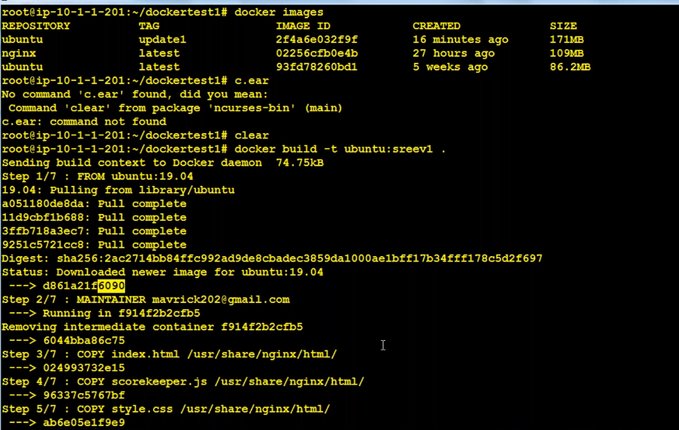

Slide 10
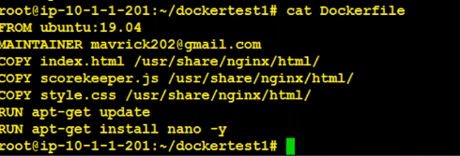

Slide 11
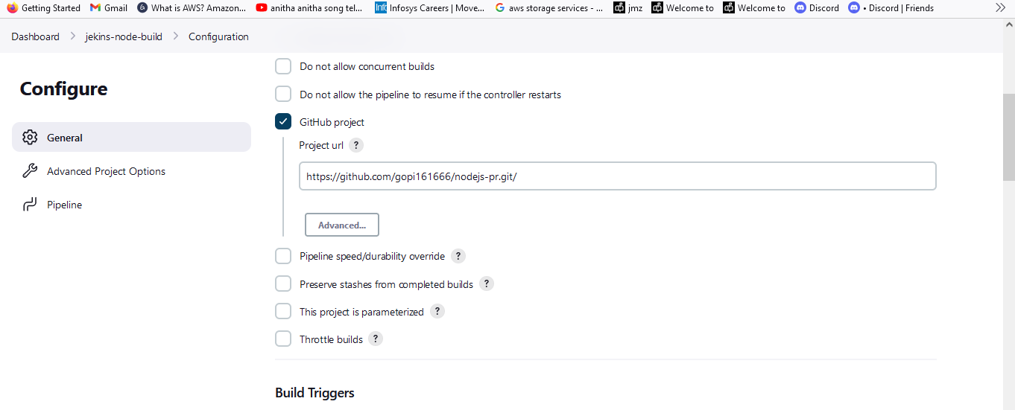

Slide 12
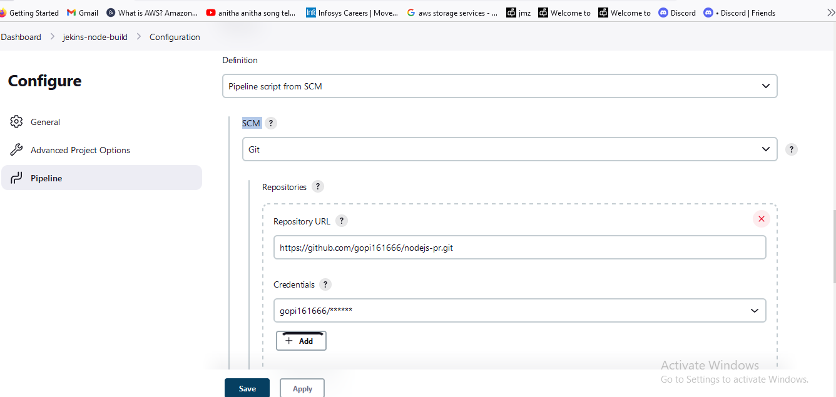

Slide 13
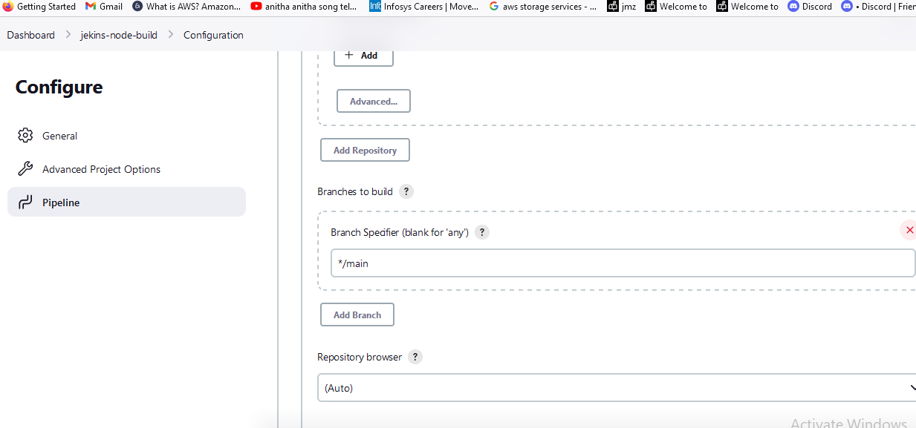

Slide 14
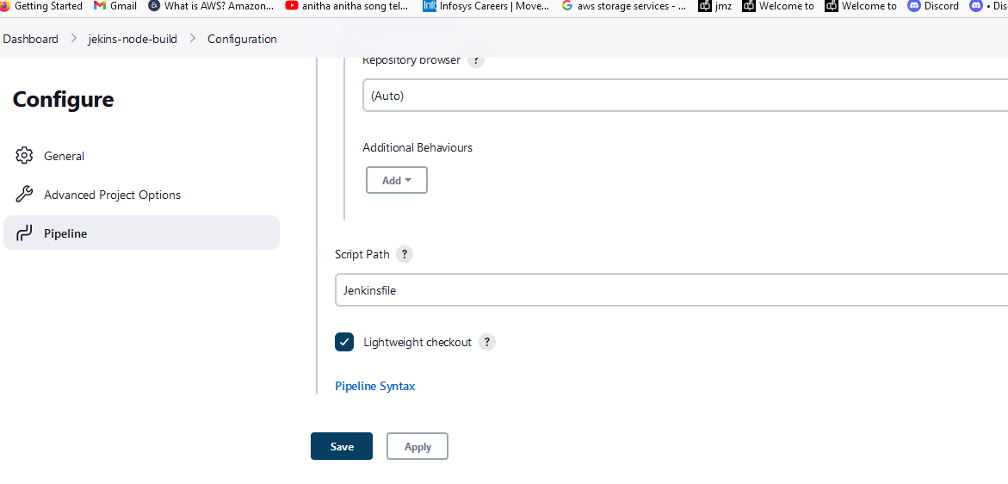

Slide 15
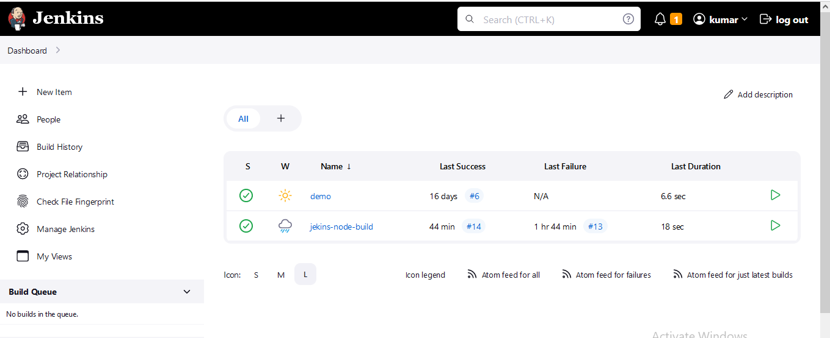

Slide 16
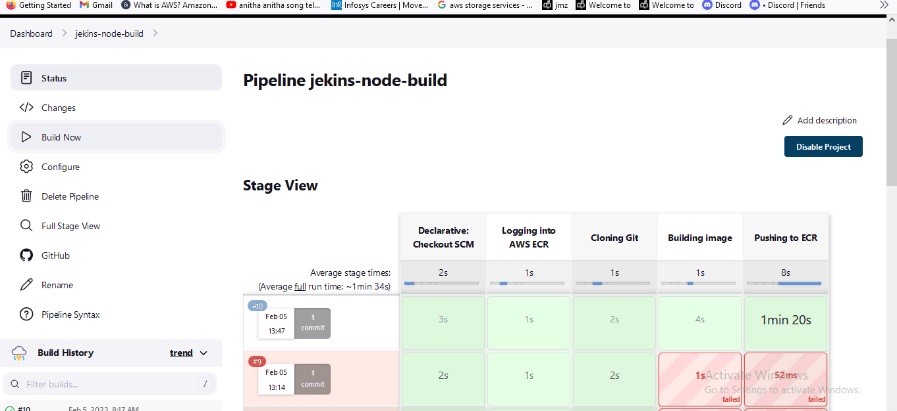

Slide 17
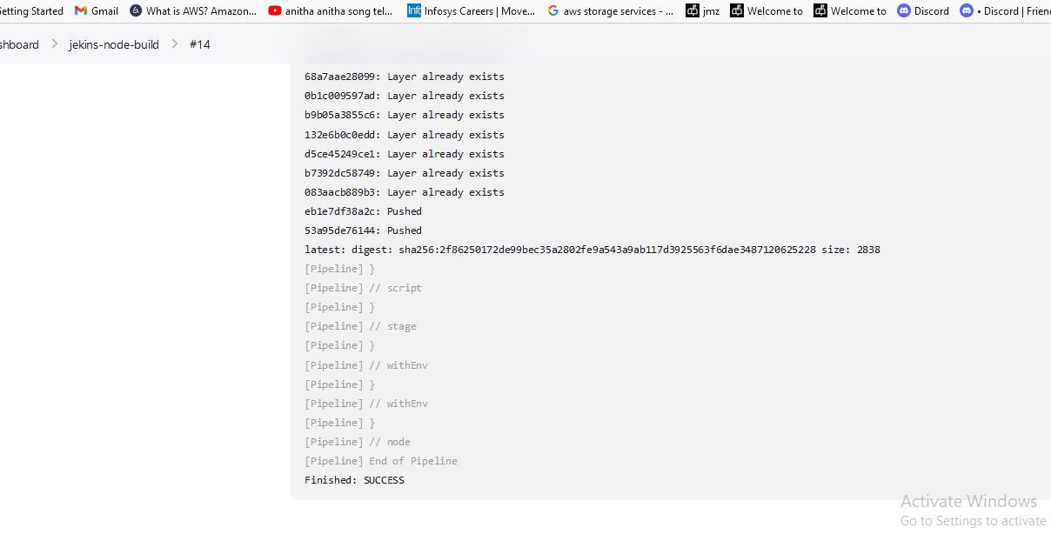

Slide 18
